Slide 1


Increasing Income: an inflation hedge
Learn how increasing income potential from Allianz can help you address inflation risks
PPT-451 (R-7/2023)
Notes:
Welcome! In this presentation you will learn how increasing income potential can help address inflation risks

Slide 2

Inflation erodes your buying power in retirement as necessities become more expensive.
INFLATION OF $20 SINCE 1980
Source: in2013dollars.com as of 3/22/22.
Notes:
Inflation erodes your buying power in retirement as necessities become more expensive. Let’s look at the inflation of $20 in 1980. Maybe you are buying a bag of groceries for $20. By 1990, that bag of groceries cost $31.72. The inflation continues to increase, and by 2022 the bag of groceries would cost $68.86!

Slide 3



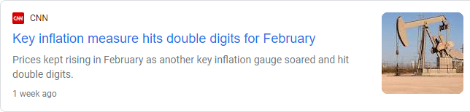
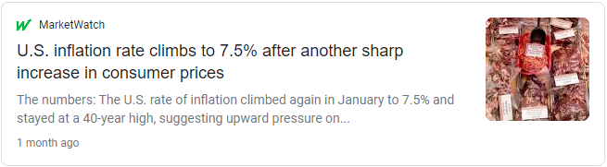



Inflation worries dominate the news
Notes:
Inflation is a hot topic in the news right now. Inflation is affecting many market sectors. In 2022 inflation was above 7%.

Slide 4
Inflation risk seen as biggest risk
36%
of respondents now view
rising inflation as the
single greatest risk to
their retirement plans.
 | 2022 | 2021 | 2020
Rising inflation | 36% | 25% | 8%
Outliving my money | 7% | 8% | 10%
Increased health care costs | 8% | 8% | 13%
Job security | 6% | 7% | 12%
Allianz Life Insurance Company of North America conducted an online survey, the 2022 Allianz Life New Year’s Resolutions Study, November, 2022 with a nationally representative sample of 1,000 respondents ages 18 years or older.
Notes:
The Annual New Year’s Resolution study from Allianz Life Insurance Company of North America, or Allianz, finds that rising inflation is seen as the biggest risk to Americans’ retirement plans in 2023. The percentage as more than tripled from 2020.

Slide 5

Increasing income from Allianz has the opportunity to help address increasing inflation
In this presentation we’ll show you…
How increasing income works
Historical data comparing our increasing income to inflation
Notes:
I’m here today to show you that income with the opportunity to increase from Allianz, either built-in or as an extra charge rider, may help address increasing inflation. First I’ll show you how increasing income from Allianz works, then I’ll show you historical data comparing an Allianz fixed index annuity (FIA) offering increasing income to inflation.

Slide 6

The many BENEFITS of a Fixed Index Annuity
Principal
protection
Tax-deferred growth
Accumulation potential
Death Benefits
Retirement income*
Income Benefits:
Either built in or available for an additional cost
Payments begin when you elect lifetime withdrawals
May be subject to holding periods
May offer level income option or increasing income option
*Lifetime income withdrawal benefits are available either at an additional cost or built in with no additional fees.
Notes:
An FIA can offer accumulation potential.
Accumulation potential is the potential to earn interest based on changes in an external index.
Tax-deferred growth: You will not pay taxes on the interest the annuity earns until they take a withdrawal. This will help compound earned interest, so the money in the contract can accumulate faster.
A level of protection: The contract can earn interest based on an external index, but you’re not actually buying any stocks or shares of an index. This means the money in the FIA (the “principal”) is not at risk due to market losses.
Retirement Income: Annuities are designed to provide a reliable stream of retirement income, either for a set period or for as long as your client lives. Select Allianz FIAs even offer the potential for increasing income and other riders (either built in or at an additional cost) to help your client address specific needs.
FIAs also provide death benefits for your client's loved ones which can be paid out in a variety of ways.
Concerning income benefits in particular:
FIA income benefits:
Are either built in or available for an additional cost
Payments begin when you decide to take income
May be subject to a holding period before income can be taken
May offer level income or income with the opportunity to increase

Slide 7



Allianz lifetime withdrawal benefits have the opportunity to increase over time
Income can increase following any crediting period allocations earn interest
Income increases are PERMANENT
Increases can happen even after accumulation value goes to zero
Increasing income potential is provided through either built-in or optional riders at an additional cost.
Notes:
Allianz lifetime withdrawal benefits have the opportunity to increase over time. How does this work? Lifetime withdrawals can increase following any crediting period your chosen allocations earn interest. In addition, select Allianz FIAs offer an interest bonus that is also applied on top of any earned interest. Income increases are also permanent, as long as you abide to the terms of your contract. Every time your allocations earn an increase, the new higher payment is locked in. What happens when the contract’s accumulation value is depleted? Income payments still have the opportunity to increase for the remainder of your life.
Lets look at the method behind how this works.

Slide 8
Annual/multi-year reset
How it works
In the first two years, the index and accumulation values increased
ASSUMES ZERO INTEREST CREDITS
INDEX VALUE
ACCUMULATION VALUE
A The index declined between years two and three, but the accumulation value remains the same through year three with annual reset
C
B
B The contract earned no indexed interest, it also did not lose value
Accumulation Value
A
C In year three, the index did not have to make up previous losses in order for the accumulation value to earn additional interest
START
Year 1
Year 2
Year 3
Year 4
The hypothetical investment results are for illustrative purposes only and should not be deemed a representation of past or future results. Actual results may be more or less that those shown. This illustration does not represent any specific product and/or service and does not reflect the deduction of fees which will reduce results.
Assumes Annual Point-to-Point crediting method
Notes:
In this hypothetical example the blue dotted line is the value of the index and the purple line is the contract’s accumulation value. You can see in the first two years, the index and accumulation values had a modest increase. The index declined between years two and three, but the accumulation value remains the same through year three with annual reset. The contract earned no interest, but it also did not lose any value due to the market downturn. In year three, the index did not have to make up previous losses in order for the accumulation value to earn additional interest. This feature is called annual or multi-year reset.
Now lets add some numbers.

Slide 9
Increasing Income: How it works
Assumed withdrawal percentage: 5%
Assumed income withdrawal value: $500,000
Lifetime income withdrawals
Allianz fixed index annuity lifetime income withdrawal value
$27,053
Income withdrawal
$26,523
Income withdrawal
$25,750
Income withdrawal
$25,750
Income withdrawal
$25,000
Income withdrawal
$25,000
Income withdrawal
Income increases each year interest is credited
Income withdrawal value $500,000
Income withdrawal value
Year 1
Year 2
Year 3
Year 4
Year 5
Index change
-3.0
+3.0
-4.0
+3.0
+2.0
The hypothetical investment results are for illustrative purposes only and should not be deemed a representation of past or future results. Actual results may be more or less that those shown. This illustration does not represent any specific product and/or service.
Notes:
In this hypothetical example, the purple line and income withdrawal amounts represent an Allianz fixed index annuity (FIA) with the annual reset income benefit. The Allianz FIA begins with a hypothetical income withdrawal value of $500,000 and an initial withdrawal percentage of 5%, providing a hypothetical initial withdrawal payment of $25,000. As you can see the contract’s income value is reduced by this payment.
At the end of contract year 1, the hypothetical external index chosen has a negative 3% change from its value one year ago. The annual income withdrawal payment remains at $25,000 for the upcoming year. The income withdrawal value is reduced by the withdrawal payment.
At the end of contract year 2, the index has a positive 3% change from a year ago (subject to the cap, spread, or participation rate of the chosen allocation). This is applied to the income withdrawal value. And because the Allianz FIA uses the annual reset method, the income withdrawal also increases by 3% to equal $25,750.
Next, even though there has been another negative year, the withdrawal payment remains the same as the previous year.
At the end of contract year 4, the external index shows a positive 3% change from a year ago. The income payment increases to $26,523.
At the end of contract year 5, the external index shows another positive change from the year before. Once again, the income payment would increase in year 6 by 2% - up to $27,053.

Slide 10
Hypothetical comparison: 3.25% inflation with fixed income vs. hypothetical increasing income annuity
Fixed income | Fixed Income
Years | Purchasing power | Value in today’s dollars
0 | 100% | $10,000.00
5 | 88% | $8,799.13
10 | 75% | $7,498.76
15 | 64% | $6,390.56
20 | 54% | $5,446.14
25 | 46% | $4,641.29
30 | 40% | $3,955.38
Hypothetical increasing income annuity | Fixed Income
Years | Purchasing power | Value in today’s dollars
0 | 100% | $10,000.00
5 | 105% | $10,493.13
10 | 111% | $11,143.87
15 | 118% | $11,834.97
20 | 126% | $12,568.93
25 | 133% | $13,348.41
30 | 142% | $14,176.23
Assumes a 3% return for the hypothetical increasing income annuity. The hypothetical investment results are for illustrative purposes only and should not be deemed a representation of past or future results. Actual results may be more or less that those shown. This illustration does not represent any specific product and/or service.
Notes:
As I mentioned earlier, since 1914, inflation has averaged 3.25%. And as we discussed earlier, in 2021, we saw inflation jump to 7%. This high inflation rate is expected to continue into 2022.
Here is what happens to the purchasing power of a fixed $10,000 income stream over a 30 year retirement assuming a 3.25% inflation rate. If we look at year 15, the $10,000 adjusted for inflation only has a value of $6,390.56. After 30 years, its value has fallen to $3,955.38. For an annuity with Increasing Income, the value of $10,000 increases in spite of inflation (assuming a 3% return). At 15 years the value is $11,834.97 and at 30 years the value is $14,176.23.

Slide 11
Hypothetical comparison: 5.05% Healthcare inflation rate with fixed income vs. hypothetical increasing income annuity
Fixed income | Fixed Income
Years | Purchasing power | Value in today’s dollars
0 | 100% | $10,000.00
5 | 82% | $8,211.37
10 | 64% | $6,418.53
15 | 50% | $5,017.13
20 | 39% | $3,921.71
25 | 31% | $3,065.45
30 | 24% | $2,396.15
Hypothetical increasing income annuity | Fixed Income
Years | Purchasing power | Value in today’s dollars
0 | 100% | $10,000.00
5 | 98% | $9,792.21
10 | 95% | $9,538.54
15 | 93% | $9,291.45
20 | 91% | $9,050.75
25 | 88% | $8,816.28
30 | 86% | $8,587.90
This hypothetical illustration is Assumes a 3% return for the Allianz increasing income annuity. The hypothetical investment results are for illustrative purposes only and should not be deemed a representation of past or future results. Actual results may be more or less that those shown. This illustration does not represent any specific product and/or service.
Notes:
Now lets look at estimated inflation of healthcare premiums
If you were using this income to pay for Medicare or healthcare expenses. in 15 years, you lost 50% of the value of that income stream. Assuming a 3% return, the Increasing Income annuity, however, has only lost 7% of its value.

Slide 12
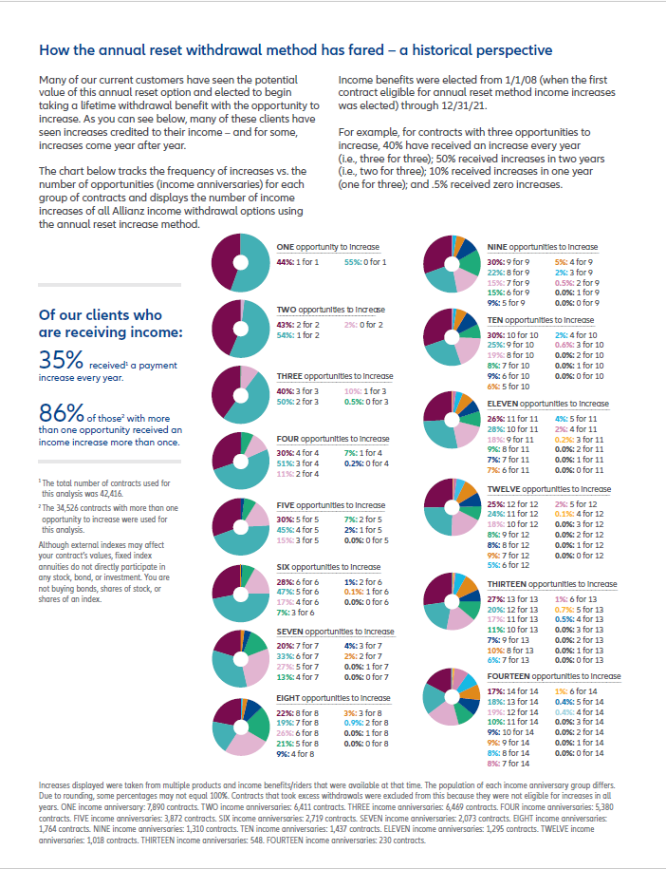
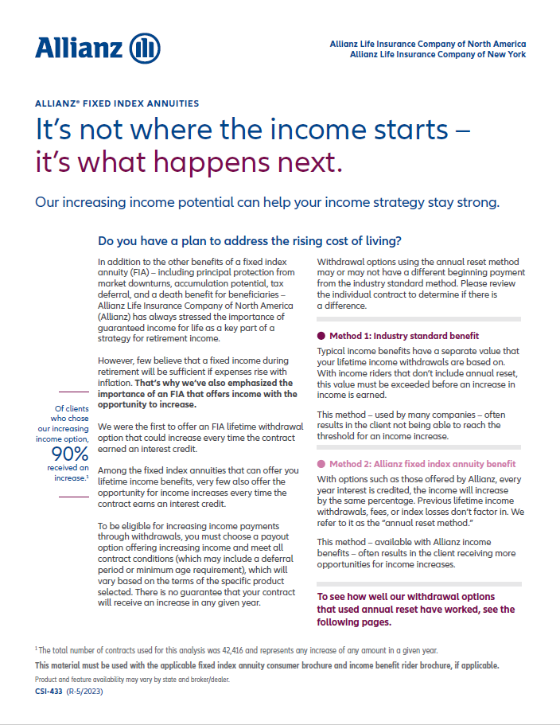
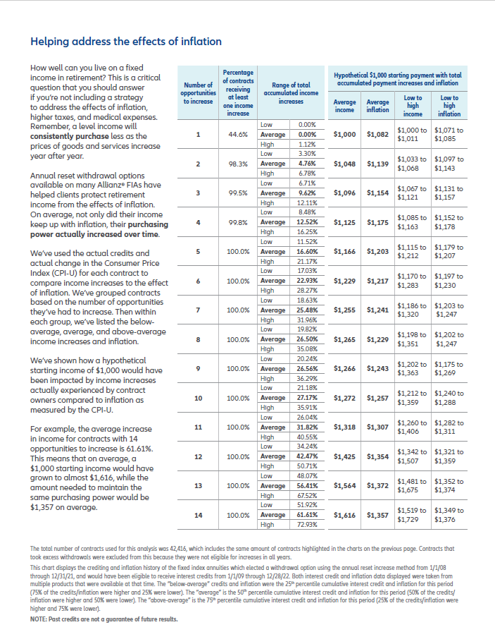
We’ve tracked the performance of our increasing income option and can show you the data
For full data see brochure CSI-433.
Notes:
We don’t just have hypothetical illustrations. We’ve actually tracked the performance of our increasing income option and can show you the data.

Slide 13
How likely is an increasing income?
Of clients who chose our increasing income option 90%
HAVE RECEIVED AN INCREASE.¹
Of our clients who are RECEIVING INCOME 35%
RECEIVED² A PAYMENT INCREASE EVERY YEAR.
Of those with more than one opportunity
86%
received an income increase MORE THAN ONCE.³
There is no guarantee that a contract will receive an increase in any given year.
The total number of opportunities to increase was tracked for all contracts with income benefits that use the annual reset method during income. Increasing income potential is provided through either built-in or optional riders at an additional cost. Past income payment increases are not a guarantee of future results. ¹ Percentage of clients taking income who have received at least one increase. The total number of contracts used for this analysis was 42,416, and represents any increase of any amount in a given year. Income payments were elected from 1/1/2008 through 12/31/2021. Income increases are reflective of multiple products and income benefits that were available at that time. Individual contracts may have seen varying amounts of income increases. ² The total number of contracts used for this analysis was 42,416. Income benefits were elected from 1/1/08 through 12/31/21. ³ 34,526 contracts with more than one opportunity to increase were used for this analysis. Income benefits were elected from 1/1/08 through 12/31/21. Increasing income opportunity may be provided through either built-in or additional cost riders.
Notes:
We’re proud to say that for [42,416] contracts with the opportunity for an income increase, [90%] received at least one increase and [35%] received a payment increase every year. And of those with more than one opportunity, [86%] received an income increase more than once.

Slide 14
How big are the increases?
Income increases based on number of years with the opportunity to increase
Number of opportunities to increase | 1 | 2 | 3 | 4 | 5 | 6 | 7 | 8 | 9 | 10 | 11 | 12 | 13 | 14
Average of total accumulated income increases | 0.00% | 4.76% | 9.62% | 12.52% | 16.60% | 22.93% | 25.48% | 26.50% | 26.56% | 27.17% | 31.82% | 42.47% | 56.41% | 61.61%
Range of total accumulated income increases | 0.00% - 1.12% | 3.30% - 6.78% | 6.71% -12.11% | 8.48% -16.25% | 11.52 -21.17% | 17.03%-28.27% | 18.63%-31.96% | 19.82%-35.08% | 20.24%-36.29% | 21.18%-35.91% | 26.04%-40.55% | 34.24%-50.71% | 48.07% - 67.52% | 51.92% - 72.93%
The total number of contracts used for this analysis was 42,416. Contracts that took excess withdrawals were excluded from this because they were not eligible for increases in all years.
This chart displays the crediting and inflation history of the fixed index annuities which elected a withdrawal option using the annual reset increase method from 1/1/08 through 12/31/21, and would have been eligible to receive interest credits from 1/1/09 through 12/28/22. Both interest credit and inflation data displayed were taken from multiple products that were available at that time. The “below-average” credits and inflation were the 25th percentile cumulative interest credit and inflation for this period (75% of the credits/inflation were higher and 25% were lower). The “average” is the 50th percentile cumulative interest credit and inflation for this period (50% of the credits/inflation were higher and 50% were lower). The “above-average” is the 75th percentile cumulative interest credit and inflation for this period (25% of the credits/inflation were higher and 75% were lower). Note: Past credits are not a guarantee of future results.
Notes:
How big are Allianz income increases historically? These income increases are grouped based on the number of years with the opportunity to increase. If the contract only had one year of income, the average total accumulated income increases was 0.00%. The range of outcomes was 0.00% to 1.12%. If you jump to 14 years of increasing income opportunity, the average accumulated increase was 61.61%, with a low of 51.92% and a high of 72.93%.
Keep in mind, there is no guarantee that increasing income will always keep up with inflation in the future.

Slide 15
Can increasing income keep up with inflation?
Hypothetical $1,000 starting payment with total accumulated payment increases and inflation.
Increasing income
AVERAGE income and AVERAGE inflation
Inflation
The total number of contracts used for this analysis was 42,416. Contracts that took excess withdrawals were excluded from this because they were not eligible for increases in all years.
This chart displays the crediting and inflation history of the fixed index annuities which elected a withdrawal option using the annual reset increase method from 1/1/08 through 12/31/21, and would have been eligible to receive interest credits from 1/1/09 through 12/28/22. Both interest credit and inflation data displayed were taken from multiple products that were available at that time. The “below-average” credits and inflation were the 25th percentile cumulative interest credit and inflation for this period (75% of the credits/inflation were higher and 25% were lower). The “average” is the 50th percentile cumulative interest credit and inflation for this period (50% of the credits/inflation were higher and 50% were lower). The “above-average” is the 75th percentile cumulative interest credit and inflation for this period (25% of the credits/inflation were higher and 75% were lower). Note: Past credits are not a guarantee of future results.
Notes:
Can increasing income keep up with inflation? We’ve tracked that too! These charts compare the effect of increasing income and inflation on a $1,000 payment. This particular chart compares average income increases to an average rise in inflation. You can see that contracts with 1 through 5 opportunities are slightly behind inflation but those with 6 or more opportunities for increases, payments have historically outpaced inflation.

Slide 16
Can increasing income keep up with inflation?
Hypothetical $1,000 starting payment with total accumulated payment increases and inflation.
Increasing income
AVERAGE income and HIGH inflation
Inflation
The total number of contracts used for this analysis was 42,416. Contracts that took excess withdrawals were excluded from this because they were not eligible for increases in all years.
This chart displays the crediting and inflation history of the fixed index annuities which elected a withdrawal option using the annual reset increase method from 1/1/08 through 12/31/21, and would have been eligible to receive interest credits from 1/1/09 through 12/28/22. Both interest credit and inflation data displayed were taken from multiple products that were available at that time. The “below-average” credits and inflation were the 25th percentile cumulative interest credit and inflation for this period (75% of the credits/inflation were higher and 25% were lower). The “average” is the 50th percentile cumulative interest credit and inflation for this period (50% of the credits/inflation were higher and 50% were lower). The “above-average” is the 75th percentile cumulative interest credit and inflation for this period (25% of the credits/inflation were higher and 75% were lower). Note: Past credits are not a guarantee of future results.
Notes:
But what if inflation is high? We also compared high inflation during these times periods to historical income increases. And with average income increases, the hypothetical payment stays close to inflation and even outpaces high inflation in some cases.

Slide 17
Can increasing income keep up with inflation?
Hypothetical $1,000 starting payment with total accumulated payment increases and inflation.
Increasing income
LOW income and HIGH inflation
Inflation
The total number of contracts used for this analysis was 42,416. Contracts that took excess withdrawals were excluded from this because they were not eligible for increases in all years.
This chart displays the crediting and inflation history of the fixed index annuities which elected a withdrawal option using the annual reset increase method from 1/1/08 through 12/31/21, and would have been eligible to receive interest credits from 1/1/09 through 12/28/22. Both interest credit and inflation data displayed were taken from multiple products that were available at that time. The “below-average” credits and inflation were the 25th percentile cumulative interest credit and inflation for this period (75% of the credits/inflation were higher and 25% were lower). The “average” is the 50th percentile cumulative interest credit and inflation for this period (50% of the credits/inflation were higher and 50% were lower). The “above-average” is the 75th percentile cumulative interest credit and inflation for this period (25% of the credits/inflation were higher and 75% were lower). Note: Past credits are not a guarantee of future results.
Notes:
What about the worst case scenario – low income increases and high inflation? You’ll see that contracts with 1 through 12 opportunities for income increases stay close to the inflation payment.

Slide 18

Summary
Inflation is a major concern
Increasing income offers permanent increases even after the accumulation value goes to zero
Our historical data shows that our clients’ increases have proven effective in helping address inflation risk
Notes:
To summarize…
Inflation is a major concern.
Increasing income from Allianz offers permanent increases even after the contract accumulation value goes to zero.
Our historical data shows that our clients’ increases have proven effective in helping address inflation risk.

Slide 19
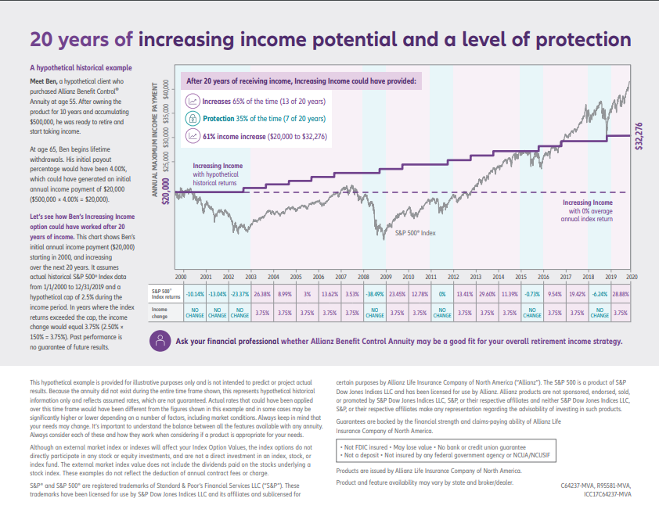
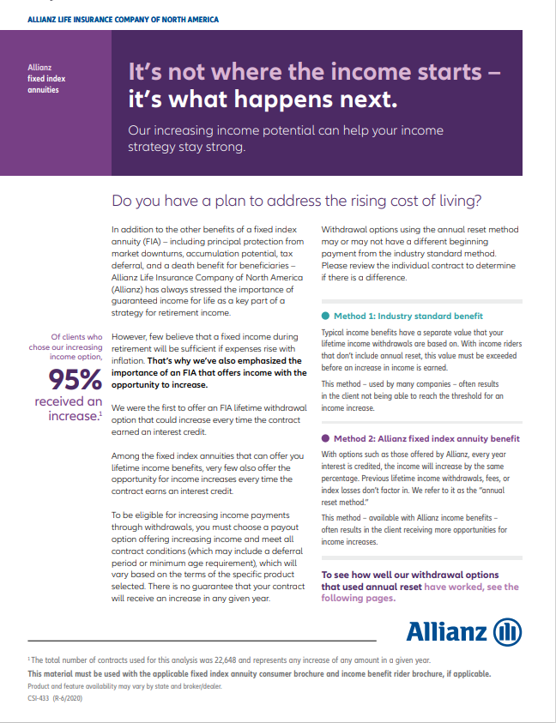

For additional information, contact your financial professional.
Thank you.
Products are issued by Allianz Life Insurance Company of North America.
Guarantees are backed by the strength and claims paying ability of the issuing company.
Notes:
For more information, contact your Allianz financial professional today. Thank you!

Slide 20

OUR MISSION
We secure your future

